Slide 1

Basics of Neural Network Programming
Binary Classification
deeplearning.ai

Slide 2
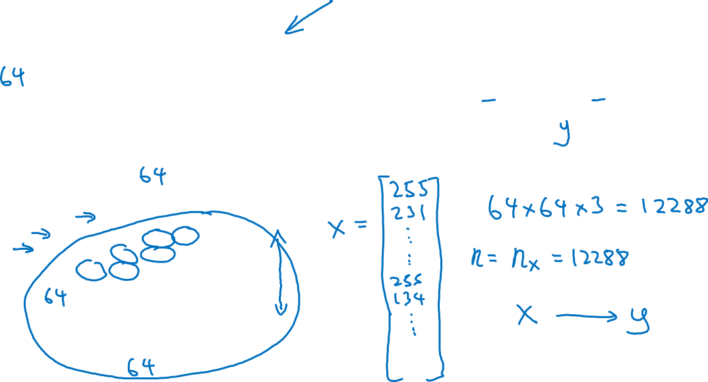
Binary Classification
1 (cat) vs 0 (non cat)
Blue
Green
Red

Slide 3
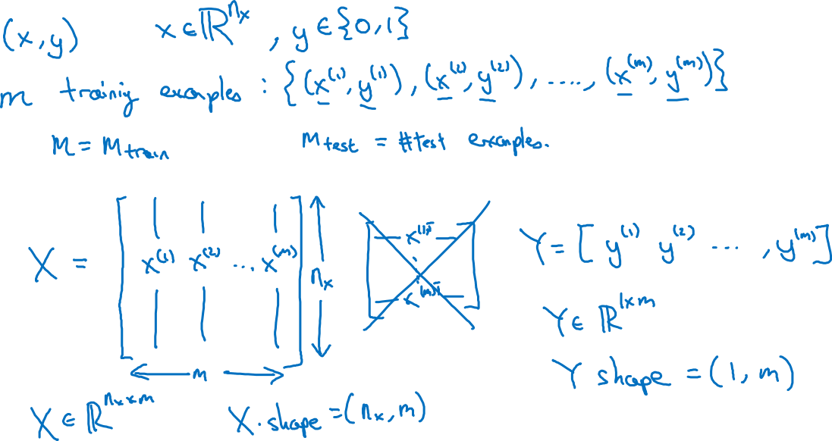
Notation

Slide 4
Basics of Neural Network Programming
Logistic Regression
deeplearning.ai

Slide 5
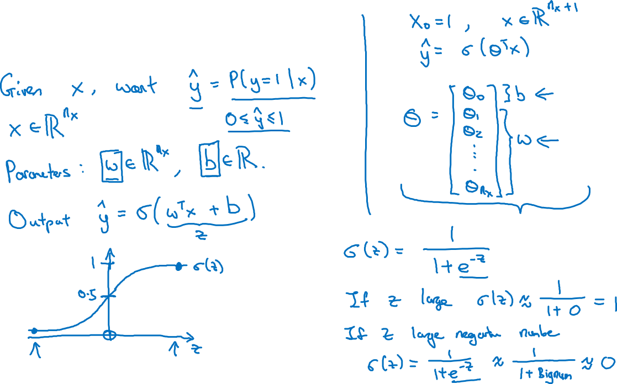
Logistic Regression

Slide 6
Basics of Neural Network Programming
Logistic Regression
cost function
deeplearning.ai

Slide 7

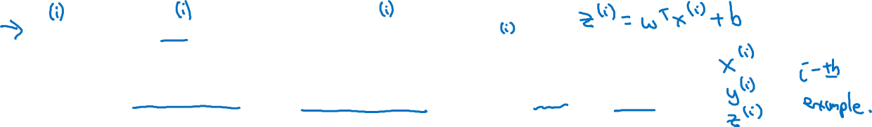
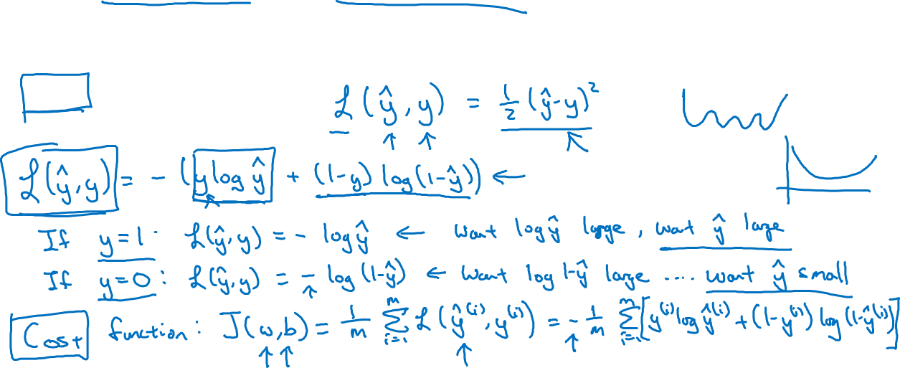

Logistic Regression cost function
, where
Given $\left\{{(x}^{(1)},y^{(1)}\text{)}\text{,}\text{…}\text{,}{(x}^{(m)},y^{(m)}\text{)}\right\},$want ${\hat{y}}^{(i)}≈y^{\left(i\right)}$.
Loss (error) function:

Slide 8
Basics of Neural Network Programming
Gradient Descent
deeplearning.ai

Slide 9
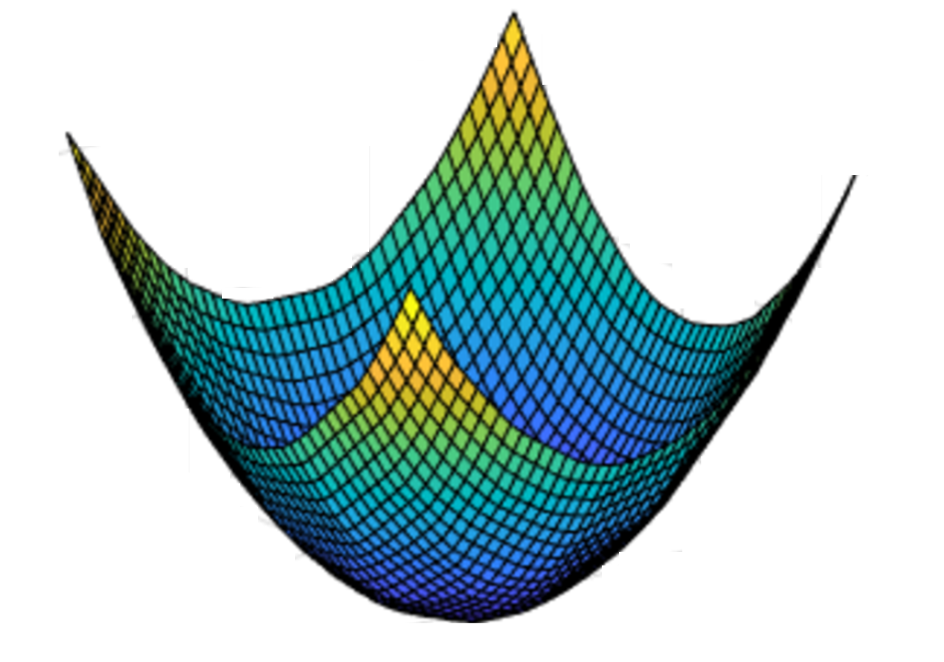
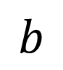



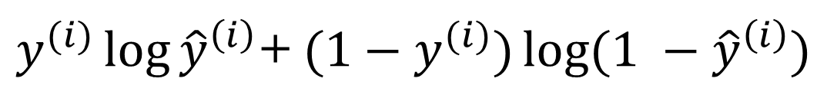

Gradient Descent
Recap: $\hat{y}= σ\left(w^{T}x+b\right)$, $σ\left(z\right)=\frac{1}{1+e^{−z}}$
$$\frac{1}{m}\sum_{i=1}^{m}{ }$$
$ℒ({\hat{y}}^{\left(i\right)},y^{(i)})$ $=$
$$−\frac{1}{m}\sum_{i=1}^{m}{ }$$
$$J\left(w,b\right)=$$
$y^{(i)}\log{{\hat{y}}^{\left(i\right)}}$+ $({1−y}^{(i)})\log{(1 −{\hat{y}}^{\left(i\right)})}$
Want to find $w,b$ that minimize $J\left(w,b\right)$
$$J\left(w,b\right)$$
$$b$$
$$w$$

Slide 10
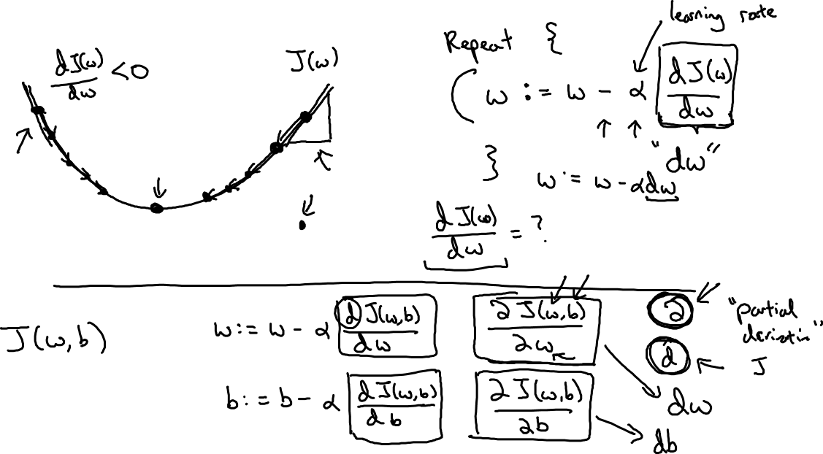

Gradient Descent
$$w$$

Slide 11
Basics of Neural Network Programming
Derivatives
deeplearning.ai

Slide 12
Intuition about derivatives
$$f\left(a\right)=3a$$
$$a$$

Slide 13
Basics of Neural Network Programming
More derivatives examples
deeplearning.ai

Slide 14
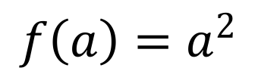
Intuition about derivatives
$$f\left(a\right)=a^{2}$$
$$a$$

Slide 15
More derivative examples

Slide 16
Basics of Neural Network Programming
Computation Graph
deeplearning.ai

Slide 17
Computation Graph

Slide 18
Basics of Neural Network Programming
Derivatives with a Computation Graph
deeplearning.ai

Slide 19
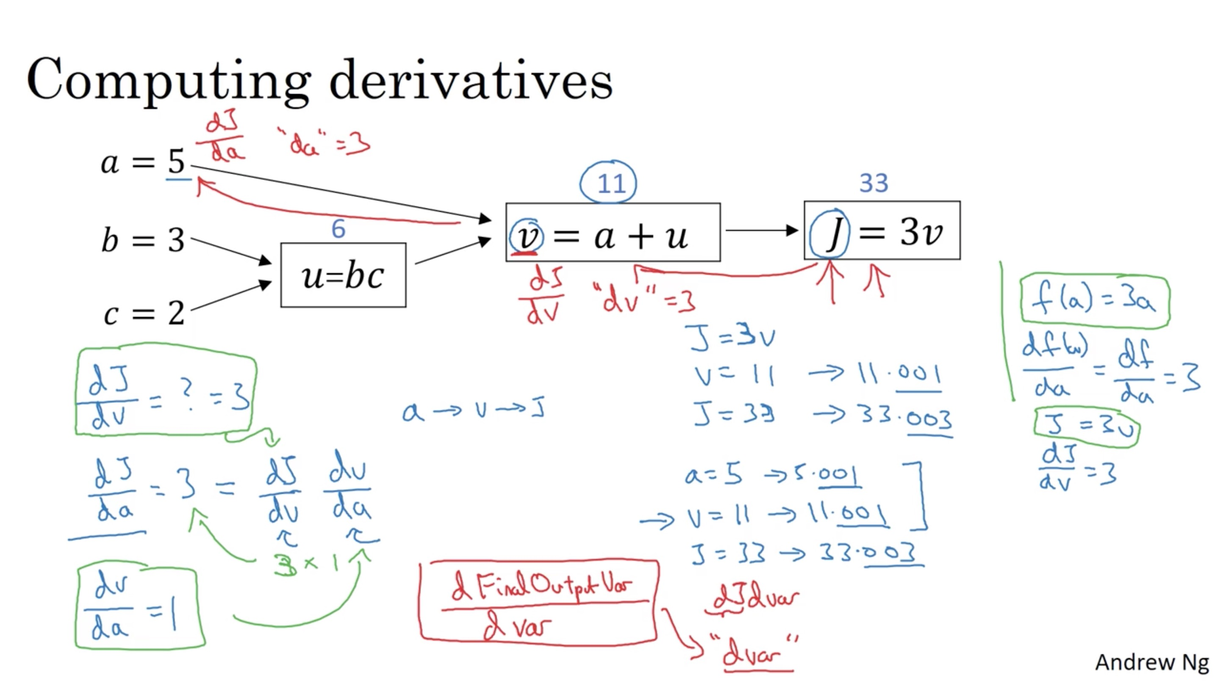

Slide 20
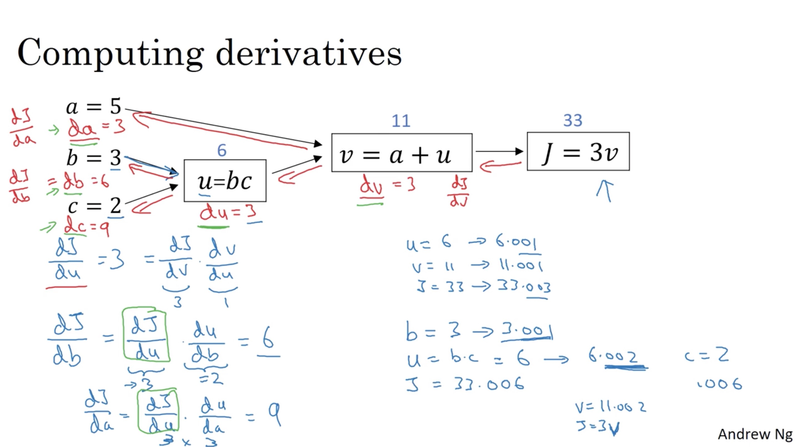

Slide 21
Basics of Neural Network Programming
Logistic Regression
Gradient descent
deeplearning.ai

Slide 22
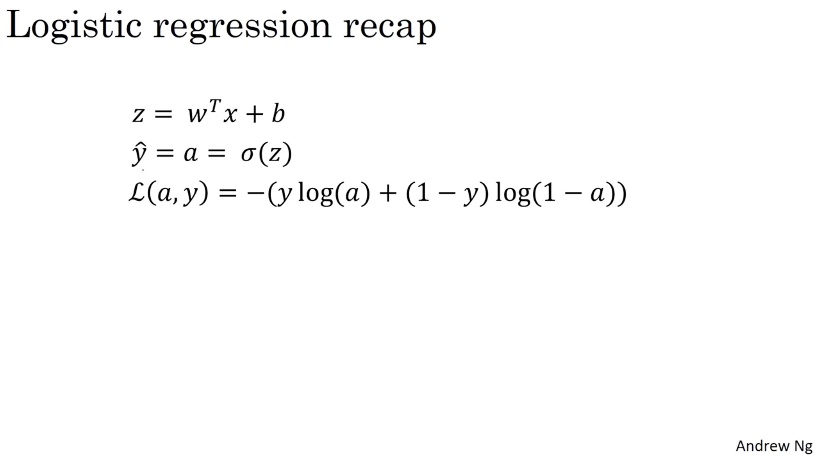

Slide 23
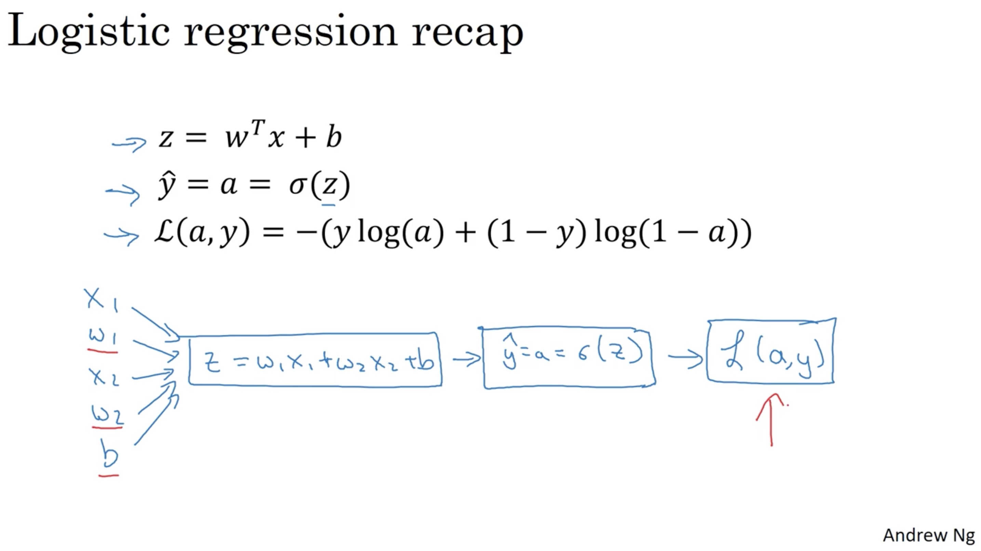

Slide 24
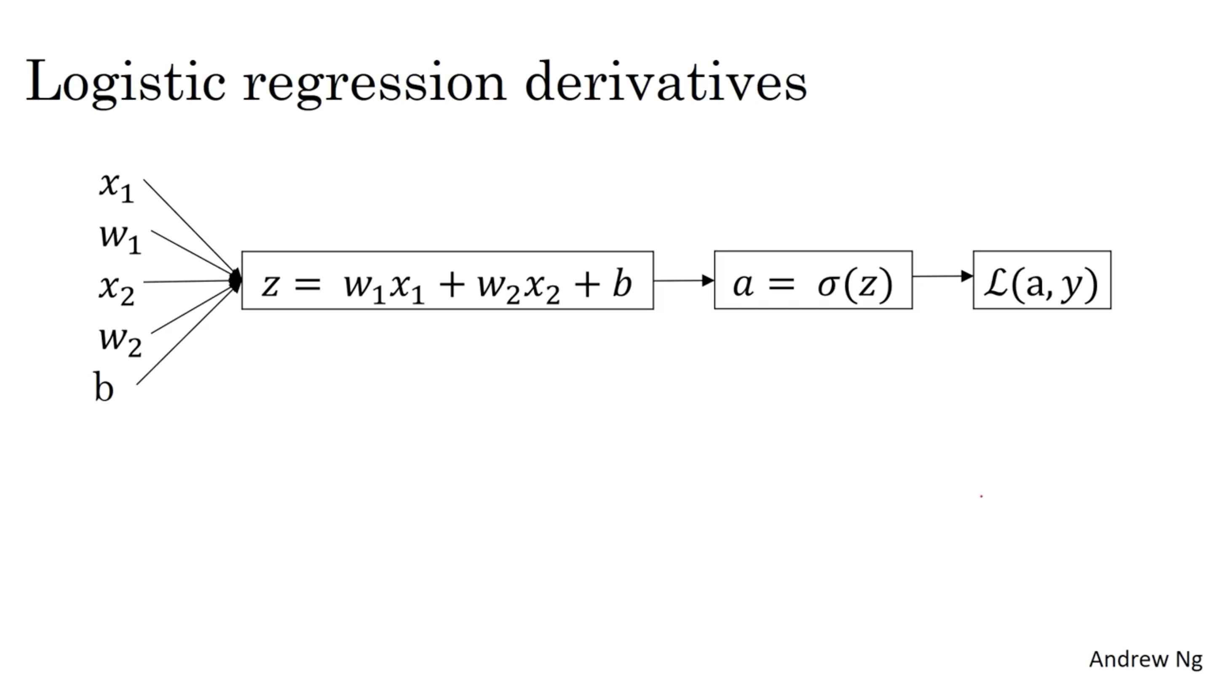

Slide 25
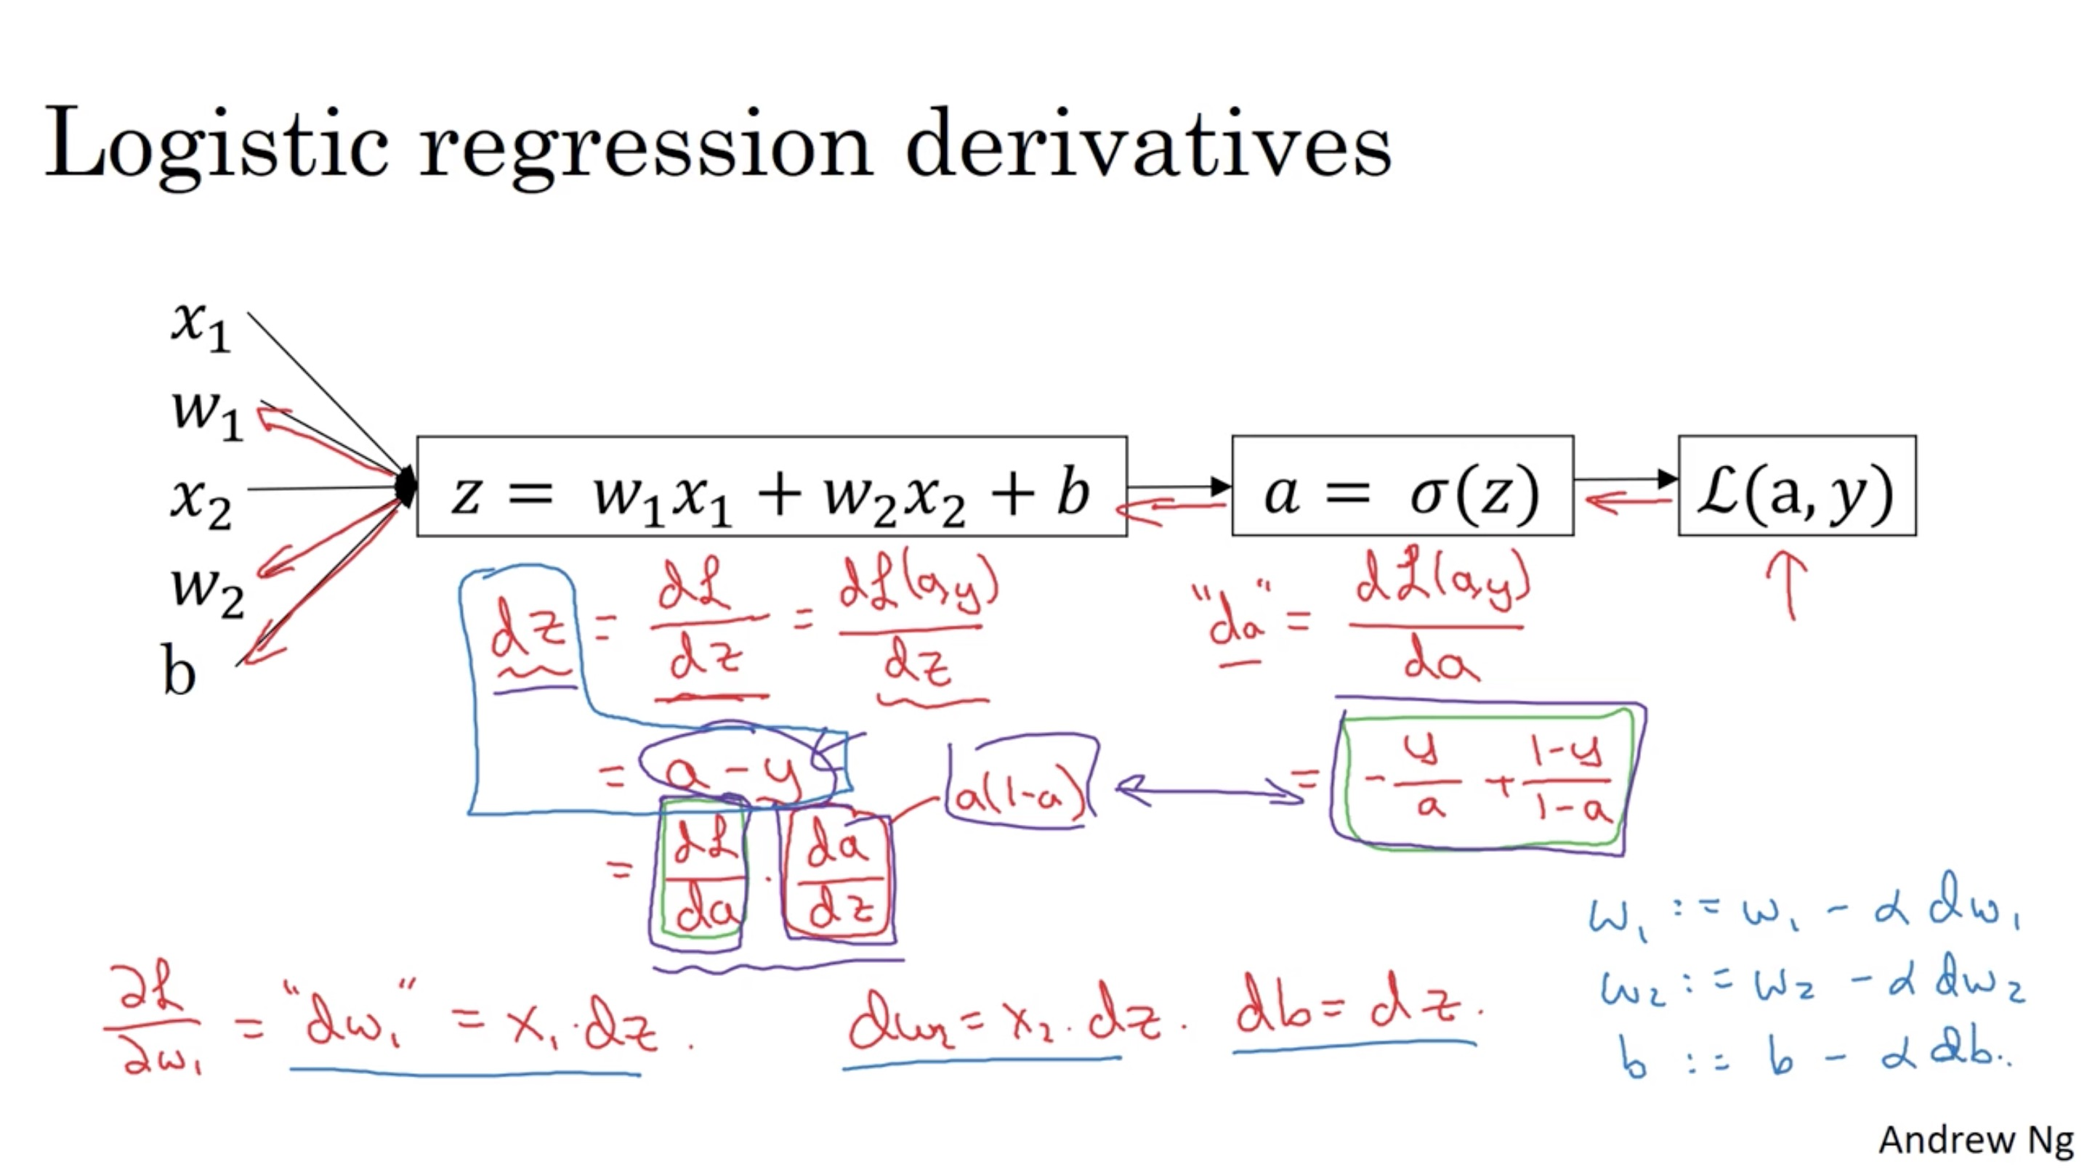

Slide 26
Basics of Neural Network Programming
Gradient descent
on m examples
deeplearning.ai

Slide 27
Logistic regression on m examples

Slide 28
Logistic regression on m examples

